Slide 1
Design Patterns

Slide 2
About
Umar Lone
Poash Technologies [www.poash.com]
C/C++, C++2a, Advanced C++, Boost, ACE, STL, Win32 SDK, MFC, COM, ATL, Design Patterns, Linux, Bash Shell Scripting, Core Java, .NET Framework, C#, Android, Objective C, iOS, OOAD, UML, OpenMP, Unity3D

Slide 3
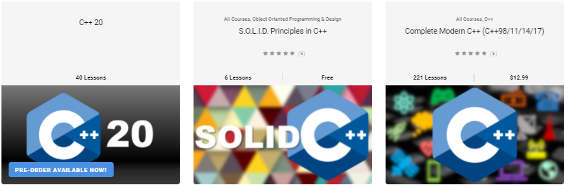

learning.poash.com

Slide 4
Objectives
At the end of this training, you’ll be able to
Understand & implement design principles
Identify bad design
Identify situations that require patterns
Identify patterns in existing code
Implement patterns in Java, C++ or C# (or any OO language)

Slide 5
Purpose of Software
Why do we write software?
to solve problems
to ease complexity
to automate tasks
to work efficiently
Is writing software easy?
Software is complex!!!

Slide 6
Why Software Is Complex?
Grady Booch mentions following elements that are responsible for the complexity of the software
Unavoidable domain complexity
Impedance mismatch between users & developers
users may find it difficult to express their requirements
Changing nature of requirements
Difficulty in managing the developmental process
big teams
Flexibility possible through software
Problems of characterizing the behavior of discrete systems
Notes:
The four elements of complexity of software domain are
Complexity of the problem domain – Through software we try to solve a number of problems, which have unavoidable complexities. Think of a simulation application that simulates the working of an aircraft. The raw functionality of such systems is quite difficult to comprehend and also adds up the non functional requirements such as usability, performance, cost, reliability, etc. This unrestrained external complexity is the cause of complexity that Brooke writes about.
The common reason of the complexity is the impedance mismatch that exists between the users of a system and its developers. It is generally hard for the users to express precise requirements in the form that developers can understand. In most of the cases, users have only vague ideas of what they want from the system. Users and developers would usually lack expertise in the problem domain and might have different perspectives and assumptions on the nature of the problem.
Things are further complicated by the fact that the requirements of the software systems often change during its development. After seeing prototypes or design documents, user better understands his needs and articulates his real needs that causes the software to change. Or the requirements might change for a different reason altogether.
Since, a lot of investment in terms of time & money goes into such software, it is not possible to scrap it every time the requirements change
Difficulty of managing the development process – The fundamental task of the software development team is to give an illusion of simplicity. The users have to be shielded from the vast complexity of the software. Such software is huge in size and we try to invent ways of writing less code, such as using frameworks or reusing existing code. The whole process is managed through teams of developers, project managers & architects. It is impossible for one person to understand such system completely. But having teams poses a different set of challenges. More developers mean more complex communication and hence, difficult coordination especially if the teams are in different geographical locations.
Flexibility possible through software – In industries such as manufacturing, construction, etc, most of the components are not produced in-house. Rather, they are ordered from other companies. But in software industry, the opposite is true. Since, software gives us great flexibility, it is possible for the developer to express any kind of abstraction. This turns out to be very addictive, but it also forces the developers to create all the primitive building blocks upon which such abstractions would stand. While other industries have uniform codes and standards, very few standards exist in the software industry. This causes software development to be a human intensive effort
Problems of characterizing the behavior of software systems – It is possible to predict the behavior of certain systems. We know if the brake is applied while the car is moving, the car will come to a stop (assuming the brakes are working fine). But in software systems making such predictions are difficult. A normal sized application might have thousands of variables, multiple threads executing simultaneously, memory allocations on stack & heap, etc. This application is executed on computers which has discrete components with discrete states. Such discrete systems have a finite number of possible states and in large systems there is a combinatorial explosion that makes this number very large. So we try to design our systems with a separation of concerns, so that the behavior of one part may not effect the other. But with so many states & events, it is not always deterministic. In the worst case, an external event may bring down a whole system, simply because the developers failed to account for one particular interaction between events. With modern day systems, it becomes even more difficult

Slide 7
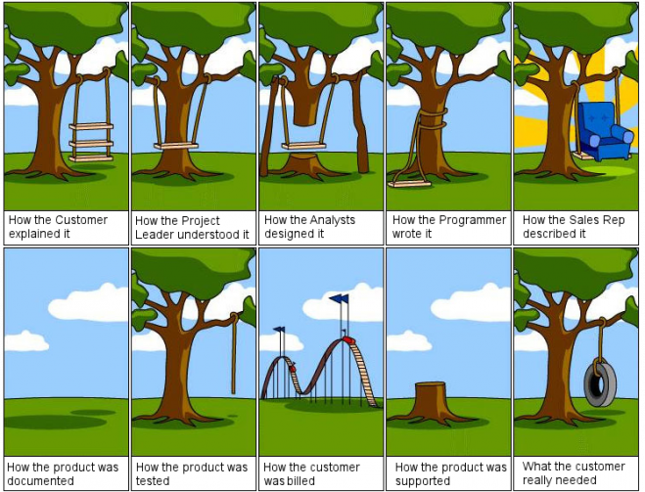

Slide 8
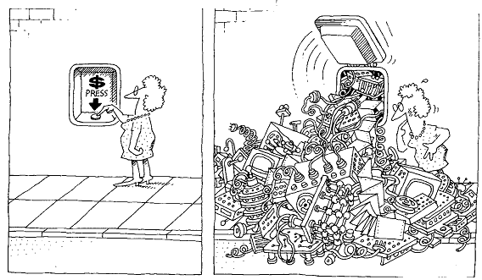
Complexity
Software developers strive to create an illusion of simplicity

Slide 9
Resolving Complexity
Human beings have a built-in mechanism for dealing with complexity
Decompose each part into smaller parts till each part makes sense individually
Finally, integrate the parts to build the final system
“divide et impera” – divide and rule
Same principle is applied to programming languages
Notes:
deal with complexity by breaking it down

Slide 10
Algorithmic Decomposition
Decomposes the problem into algorithms
Each algorithm is part of a series of steps (part of overall process)
Typically, a top-down approach
start with a big picture
break down into smaller chunks
These steps lead to the final result (like a flow chart)

Slide 11

Algorithmic Decomposition
ALGORITHM A
ALGORITHM B
ALGORITHM C
DATA

Slide 12
Disadvantages
Development based on the high-level specification
Often changes over time
parts have to be rewritten
Algorithms are very specific to the application, thus, difficult to reuse
Difficult to add new features
algorithms are wired to work together

Slide 13
Disadvantages
Data is treated with low significance
data is shared between algorithms
unintentional modification can lead to disastrous results
Focus on operations & their ordering
no idea about the entity on which operation is performed
doesn’t map to real life entities
overall understanding of the application becomes complicated

Slide 14

Object Oriented Decomposition
Humans can also abstract complexity and focus only on necessary details
unwanted details are ignored
deal with relevant details only
leads to simple entities in the problem domain
OS
Storage
Battery
Networks
Screen size
Camera
Filesystem type
Battery type
Camera aperture
Image format
Color space
USB Connector Type
Charging current
Notes:
Interview example

Slide 15
Object Definition
An object represents an individual, identifiable item, unit or entity, either real or abstract, with a well defined role in the problem domain *
-Smith and Tockey
Model some part of reality
Exists in space and time
Can be invented as outcome of a design process
Has well-defined behaviour and a definite purpose
Collaborate with other objects to provide a higher-level behaviour
* Smith, M., and Tockey, S. 1988. An Integrated Approach to Software Requirements Definition Using Objects:Boeing Commercial Airplane Support Division

Slide 16
Object Oriented Decomposition
Recognize relationship between the objects
some objects may be generalized
Understand how they interact and coordinate
The coordination gives rise to the functionality of the system
Notes:
Interview example

Slide 17
Object Oriented Decomposition
Uses bottom-up design
The system is decomposed as a set of autonomous, but cooperative agents
These agents are objects and represent key abstractions in the problem domain
designed with detail

Slide 18
Object Oriented Decomposition
Each object has its own behaviour
May model some object in the real world
The objects coordinate with each other
coordination gives rise to functionality of the system
send messages to each other

Slide 19
Object Oriented Decomposition
Messages
Object A
Object E
Behaviour & Data
Object B
Object X
Object D
Object C

Slide 20
Advantages
Follows separation of concerns
each object has its own responsibility
objects are organized in a hierarchy
addresses the complexity through organization
System is made of objects that represent real-life entities
Maps closely to real-world problems

Slide 21
Advantages
Data has high importance
part of the object, not visible externally
Enables generalization of objects
promotes reuse of common functionality
leads to smaller systems
Evolve incrementally over a period of time

Slide 22
Evolution
Early computer languages were created for scientific and mathematical operations
To accommodate complexity and large systems, new languages were invented
Procedural languages were used for a long time, until complexity of systems further increased
required reuse, scalability
Eventually, OO languages like Simula, Smalltalk, C++, Java, etc came into picture
The building block in these languages are classes & objects rather than algorithms

Slide 23
Foundations Of Object Model
Programming languages evolved for developers who were trying to build system using algorithms as their building blocks
Similarly, OO design methods have evolved to help the developers to exploit the power of OO programming languages
These methods or principles collectively form a conceptual framework called object model
It builds upon three concepts
object-oriented analysis
object-oriented design
object-oriented programming

Slide 24
Object Oriented Analysis
Method of analysis that examines the requirements from the perspective of the classes & objects found in the vocabulary of the problem domain
This is the first step for developing an object-oriented system
Investigation of problem and requirements rather solution
Focuses on what the system is supposed to do rather how it will be done
Looks at the behaviour of the system independent of its domain
Examines the real-world environment in which the system will operate

Slide 25
Object-Oriented Design
It is a method of design that implements a system using a collection of classes & objects
OO design uses different notations to express different models of the logical & physical design of a system
OOD emphasizes proper & effective structuring of the complex system using OOP
OOD transforms the conceptual model of OOA to take into account the constraints of architecture, platform, language, etc
The result is detailed description of how the system is to be built

Slide 26
Object-Oriented Programming
It is a method of implementation in which programs are organized as cooperative collections of objects, each of which represents an instance of some class, and whose classes are all members of a hierarchy of classes united via inheritance relationships
The three important points in this definition are that OO programming
uses objects, & not algorithms as its fundamental building blocks
each object is an instance of some class
classes are related to each other through inheritance relationships

Slide 27
OO Languages
Object oriented languages evolved to help the developers to exploit the power of object oriented programming
This led to concept called as object model that contains the following important pillars
Abstraction
Encapsulation
Hierarchy
Polymorphism
Modularity

Slide 28
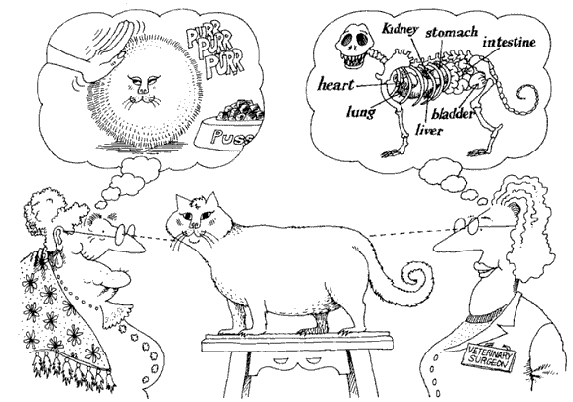
Abstraction
Abstraction focuses upon the essential characteristics of some object, relative to the perspective of the viewer
From Object-Oriented Analysis and Design with Applications
Notes:
An abstraction denotes the essential characteristics of an object that distinguish it from all other kinds of objects and thus provide crisply defined conceptual boundaries, relative to the perspective of the viewer

Slide 29
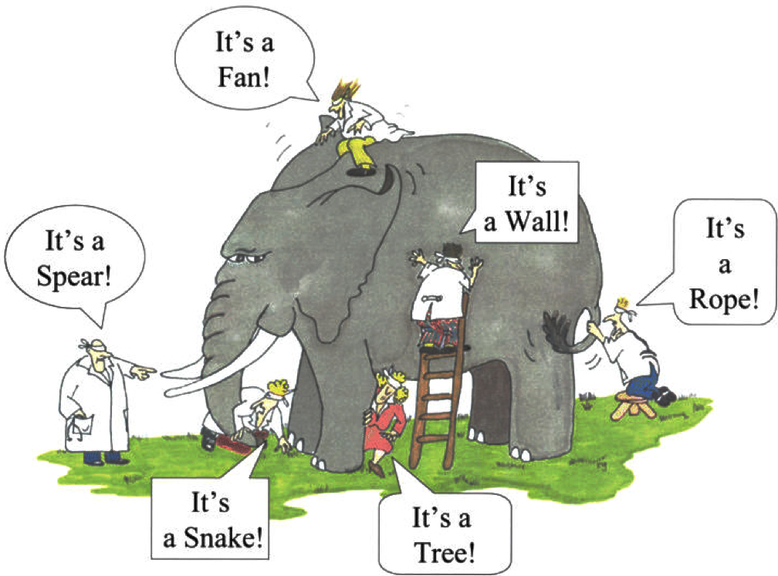
Abstraction
The abstraction is performed based on the domain
Performing correct abstraction for a given domain in necessary
Domain expertise is important for performing correct abstraction
Focus on entity abstraction
represents a useful model of domain entity
closely matches with the vocabulary of the problem domain
e.g Bank, Account, Transaction, etc
Notes:
Entity abstraction is implemented as a class/structure in OO languages

Slide 30
Abstraction Example
Design an animator component to animate movement of an image
Abstraction | Animator
Characteristics | duration start position end position image
Behaviors | Start Pause …

Slide 31
Discussion
Resolves complexity
Representation of real-life objects as software entities
Unnecessary details are left out as the focus is only on elements that are valid in the current problem domain
Easy to model a solution for a problem
A class/structure/interface is an abstraction

Slide 32
Object Collaborations
No object operates independently
Every object provides some behavior that it is responsible for
Collaborates with another to achieve the overall behavior of a system
This is an important property of object-oriented systems

Slide 33
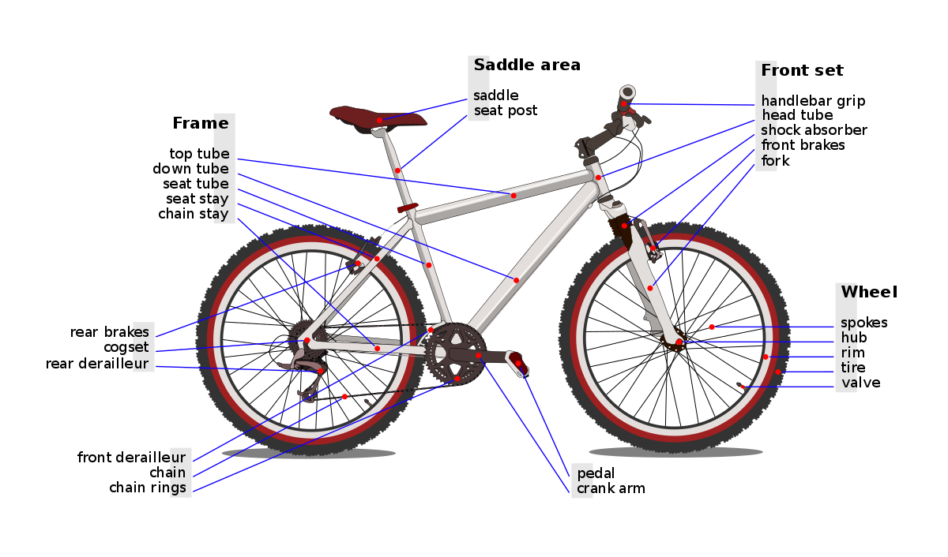
Example

Slide 34
Abstraction
The elements of abstraction provide a behaviour of the object through implementation
Upholds the contract of its behaviour
This implementation should be treated as a secret
kept hidden from clients
This is achieved through encapsulation

Slide 35
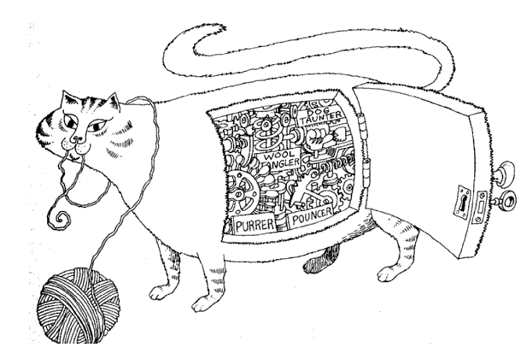
Encapsulation
Encapsulation hides the internal details of an object
From Object-Oriented Analysis and Design with Applications
Notes:
Encapsulation is the process of compartmentalizing the elements of an abstraction that constitute its structure and behavior; encapsulation serves to separate the contractual interface of an abstraction and its implementation
Abstraction & encapsulation are complementary concepts. Abstraction focuses upon behavior of an object, whereas encapsulation focuses upon the implementation that gives rise to this behavior.
Liskov says “for abstraction to work, implementations must be encapsulated”. This means that a class must have two parts: an interface and an implementation. The interface of a class captures only its outside view, encompassing our abstraction of the behavior common to all the instances of the class. The implementation of a class comprises the representation of the abstraction as well as the mechanisms that achieve the desired behavior.

Slide 36
Abstraction
The elements of abstraction provide a behaviour of the object through implementation
Upholds the contract of its behaviour
This implementation should be treated as a secret
kept hidden from clients
This is achieved through encapsulation

Slide 37
Encapsulation
Abstractions work only when encapsulated
Every class will have two parts: an interface and an implementation
Interface captures the outside view and provides the behaviour
Clients will make assumptions based on the outside view
Implementation is encapsulated, so clients cannot make any assumptions on those details
In turn, the abstraction is required to be accountable for its behaviour

Slide 38
Advantages
Clients don’t (& shouldn’t) need to see the implementation details
Change in internal implementation doesn’t effect the clients
Encapsulation decouples clients from implementation details
Enforces state changes to object only through behaviour
Helps in building scalable & flexible systems

Slide 39
Hierarchy
Hierarchy is a ranking or ordering of abstractions
Abstraction helps represent domain objects to resolve complexity
Encapsulation further hides the implementation details
The complexity can be reduced further by creating hierarchy of abstractions
hierarchy represents relationships between abstractions
Helps represent the problem domain and its objects
The important hierarchies in a complex system are
inheritance
containment

Slide 40
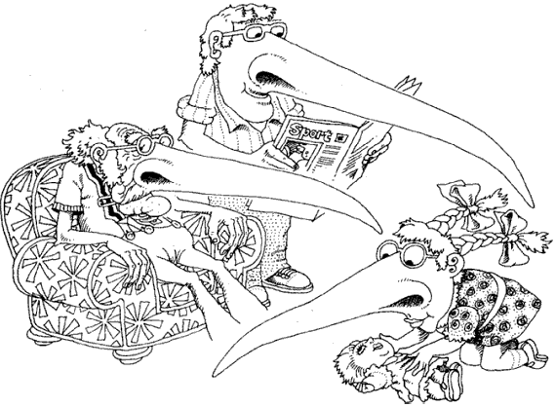
Inheritance
In “is a” relationship, a subclass will inherit the structure
& behavior of its superclass
From Object-Oriented Analysis and Design with Applications
Notes:
Consider different sorting algorithms. The behavior is same for all the algorithms, so this behavior can be standardized in a class called as SortingAlgorithm. This class can have a method called as Sort. All the other sorting algorithm classes can inherit from this class and provide a specialized behavior of sort algorithm. This asserts “is a” relationship.

Slide 41
Inheritance
Inheritance is a common technique for reusing functionality in OO systems
Often known as white-box reuse
It refers to visibility
the internal structure of the parent classes is visible to subclasses
Defined statically at compile time
The implementation of the parent class can be easily modified by overriding
Easy and straightforward to use

Slide 42
Hierarchy: "is a" Relationship
Car
ElectricCar
PetrolCar

Slide 43
Discussion
Helps in classification of objects based on their behaviour and implementation
Enables reuse of existing code, thus avoiding code duplication
Organizes the complexity and breaks it down into manageable chunks

Slide 44
Inheritance
When using inheritance incorrectly,
you can’t change the implementations inherited from the parent at run-time
a subclass is exposed to details of its parent’s implementation, so “inheritance breaks encapsulation”.
the implementation of a subclass become tightly coupled with its parent’s implementation
any change in the parent class will force the subclass to change
This creates a dependency which limits flexibility and ultimately, reusability.
Notes:
Another example can be of a Stack inheriting from an Array. You can implement push and pop by calling Array’s methods. But what would happen if the user calls clear() method of Array which is inherited into the Stack class? The Stack would be in an undefined state.

Slide 45
Example
Frame
Create:void
OnCreate(void):void
OnDestroy(void):void
SetTitle(title:string):void
Window
OnCreate:void
OnDestroy:void

Slide 46
Interface
<<interface>>
ISerializable
+Serialize(out:ofstream):void
+Deserialize(in:ifstream):void
Employee
+Serialize(out:ofstream):void
+Deserialize(in:ifstream):void
Realization Arrow
ISerializable
Employee
+Serialize(out:ofstream):void
+Deserialize(in:ifstream):void

Slide 47
Abstract Class Vs. Interface
Abstract Class
Interface
Can contain fields or methods
May provide default implementation of some behaviour
Subclasses extend the behaviour of the base
Subclasses cannot inherit from multiple abstract classes
Can have different access modifiers
Use to represent common behaviour and implementation when different subclasses are related
Contains only behaviour
Cannot contain any implementation
Subclasses implement the behaviour of the interface
Subclasses can implement multiple interfaces
All methods are public
Use to represent common behaviour that “must” be implemented by disparate classes

Slide 48
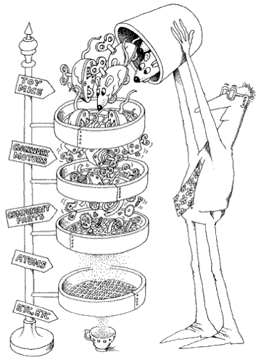
Containment
Abstractions form a hierarchy. In this example, the toy mice are composed of other objects and signifies “part of” relationship
From Object-Oriented Analysis and Design with Applications
Notes:
Example of “part of” relationship is a Window that contains a button or a classroom that contains students. Here the question of ownership is raised. In aggregation relationship, the inner object’s lifetime is not necessarily controlled by the outer object. For example, if the classroom is destroyed, the students will not be destroyed; instead they might become a part of other classroom.
Containment suggests strong relationship in which the lifetimes of the objects are intertwined together. When the outer object is destroyed, the inner object is automatically destroyed e.g. a window having a button.

Slide 49
Containment
This is a relationship between objects
Signifies “has a” relationship
One object may contain another object to reuse its behaviour
Multiple forms of containment exist
Composition
Aggregation
Association
Dependency

Slide 50
Composition
This is a strong relationship & signifies a physical containment
One object is “part of” another object
The outer object is responsible for its lifetime
E.g. Button is part of Window
When the Window is closed, the button is also destroyed

Slide 51
Example
Window
Button
AddressBook
Contact

Slide 52
Aggregation
Denotes a logical containment of an object
Weaker than composition
E.g. training has students
Training does not physically contain the students
The students are shared with other trainings
A training does not control the lifetime of its students; they exist independently

Slide 53
Example
Training
students
Training
Student
Car
Passenger

Slide 54
Association
This also implies reuse of objects
Represents a semantic connection between the classes
A class will contain a reference of another object and use it for some time
Often accompanied with phrases such as uses, controls, etc
E.g. Analyst analyses Requirements

Slide 55
Example
Analyst
analyses
Requirements
Manager
manages
Team

Slide 56
Containment
Object containment is another form of reuse
New functionality is obtained by assembling or composing objects to get more complex system
Known as “black-box reuse”, because no internal details of the objects are visible
Composition can be defined dynamically at runtime through references or pointers to other objects
Objects are accessed solely through their interfaces that reduces dependencies
Any object can be replaced at runtime by another as long as they are of the same type.

Slide 57
Containment
With containment
classes are kept encapsulated and are focused on one task unlike inheritance
class hierarchies remain small and objects are light-weight
OO systems will have more objects and the system’s behavior will depend on their interrelationships instead of being defined in one class
But containment cannot be effectively used without inheritance
Inheritance and containment thus work together in a well designed OO system

Slide 58
How to use inheritance?
Use inheritance
for representing common behavior
substitutability
overriding/polymorphism
Avoid
using inheritance for inheriting implementation
inheriting from concrete classes
Ensure the hierarchy satisfies “is a” rule (use LSP)

Slide 59
Containment Vs. Inheritance
Favor containment over inheritance
Disadvantages of improper inheritance
defined statically at compile time
inheritance breaks encapsulation
dependencies are created
Containment has several advantages over inheritance
can be defined dynamically at runtime
does not break encapsulation
loose coupling between container and contained objects

Slide 60
Polymorphism
Means different forms
These forms represent different implementations of the same behaviour in different objects
They are united via inheritance
The behaviour is invoked on the base/super object, but the action is performed on its child object
The child class overrides the implementation of the base

Slide 61
Polymorphism
OO languages support polymorphism in many ways
Compile time polymorphism or parametric polymorphism
methods are resolved at compile time (overloading, templates)
Dynamic polymorphism
methods are resolved at runtime (virtual mechanism)
Notes:
Compile time polymorphism can be achieved through function overloading or function templates in C++. In the first case, it is called as parametric polymorphism because the type of function to call is determined by examination of the parameters of the function call.
Following is an example of compile time polymorphism
#include <iostream>
using namespace std ;
class Rectangle
{
public:
void Draw()
{
cout << "Rectangle::Draw" << endl;
}
} ;
class Line
{
public:
void Draw()
{
cout << "Line::Draw" << endl;
}
} ;
template<typename Shape>
void DrawShape(Shape & shape)
{
for(int i = 0 ; i < 10 ; i++)
shape.Draw() ;
}
int main()
{
Rectangle r ;
Line l ;
DrawShape(r) ;
return 0 ;
}
Here the call to the Draw method is resolved at compile time, depending on the type of Shape.

Slide 62
Example
Shape
+Draw():void
void Render(Shape s){
s.Draw() ;
}
Line
Circle
+Draw():void
+Draw():void

Slide 63
Advantage
Promotes reuse
More classes can be added without requiring change to existing code
Certain implementations may not even require a recompilation of the binary
Works in tandem with containment and inheritance

Slide 64
OO Paradigm
Object oriented paradigm was thought to solve problems with procedural paradigm
But developers soon realized OOP does not work as promised
Hierarchy promised reuse & extensibility
Encapsulation promised safety of data
Designers began to face problems while designing the software using OO paradigm
Good designers solved the problems and documented them, so that same problems in future can be solved readily
This gave birth to design patterns - generic solutions to common problems encountered in object oriented software design
Notes:
asus rtl12+

Slide 65

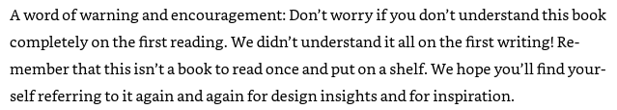
Design Patterns
The book that started it all
Published in 1995
Describes solutions to common OO design problems

Slide 66
What is a pattern?
Keyword coined by Christopher Alexander.
he noticed several buildings were constructed with a common pattern
Each pattern describes a problem which occurs over and over again in our environment,
and then describes the core of the solution to that
problem,
in such a way that you can use this solution a million times
over, without ever doing it the same way twice
Notes:
A pattern is just a way of sharing knowledge, experience. It isn't a solution in itself. It’s defined as “a proven solution for a recurring design problem that occurs within a context”. Please pay attention to the definition. The proposed solution can have different implementation alternatives, depending on the programming language or specific platform. For example, the J2EE design patterns propose a solution and implementation alternatives that may be suitable depending on what you are doing. However, the most important thing about a pattern is to understand what kind of problem solves, and that is why you should understand the problem context. Patterns are popular because they are a very good way to use a common language, to document a system and to reuse some parts of a system design. Contrary to popular belief, it's very hard to reuse existing domain objects (see the "Object-oriented Code Re-use myth") but patterns are very easy to reuse across different projects. On the other hand, a framework is a finite solution that helps you structure your code and solve a particular kind of problem. It is defined as "a partially built subsystem, for solving a specific problem and that must be instantiated for its usage". Every framework provides the basic building blocks for building your own systems according to your needs. These building blocks will be general for every problem, for example, reusable components that are ready to use [off the shelf components], interfaces that define design contracts and horizontal services. What you have to add to the framework is what is particular to your need (that is the framework instantiation). A framework may or may not be made with several patterns implementation. A framework is based upon the IoC (Inversion of Control) principle; your application just need to provide and declare some callback functions and start the framework. From there the framework is in charge of running the application, calling your callback functions whenever it's necessary. So as you can see, they are very different concepts, the main difference being that a framework is a physical and usable piece of code while a pattern is a logical design solution to a given kind of problem. I will add that every framework has its own purpose, best-practices, restrictions and limitations, and PLEASE READ THEM CAREFULLY AND GET EXPERIENCE APPLYING THEM. By experience, some frameworks are used for making things or solving needs, they were not designed for and so, users start having problems instead of getting the real benefits of using a proven, mature framework. Please also, pay attention to the maturity state of a framework. If a framework has been proven in several projects, it will do what you are expecting with high-quality, and what is more, it will evolve with its width customers using it. Another important noteworthy point is difference between API or Class Libraries and Framework. API is used for code reusability. Design patterns are used to build different parts of the frameworks. Every framework mostly has two parts: Frozen Spots and Hot Spots. Frozen Spots are designed using White Box framework. Pluggable parts of the framework are example of Hot Spots. If hot Spots are implemented as a framework, then it is called Black Box framework. There are several frameworks, some can be conceptual others can be technological, there is no restriction, they all bring building blocks, for making your own systems, faster, easier and reusing best practices of a proven common infrastructure. To name a few technical frameworks: - Struts (http://struts.apache.org/) and JSF – Java Server Faces are frameworks for building Web Interfaces. They both use the MVC design pattern, which is maybe the most used architectural pattern for building frameworks and software intensive systems. Design patterns related with MVC are: PAC Pattern and IoC. - Toplink (www.oracle.com/technology/products/ias/toplink/) and Hybernate are frameworks for object persistence. - Log4J (http://logging.apache.org/log4j/docs/) is a framework for auditory. You can use Log4J for implementing technical logs and business audit logs. - J2EE its framework for building Enterprise Applications. Its building blocks are horizontal services that provide common infrastructure and well defined interfaces in its specifications (Servlets, EJBs, JDBC, JMS, JTA among others) for building your own applications. - LEAF - Lucasian Enterprise Application Framework (http://www.lucasian.com/framework) is a white-box framework for building Enterprise Java Applications with high productivity in development and robustness in production environments. LEAF is built on top of the J2EE Design Patterns framework and open-source frameworks such as, Log4J, Apache Axis and Jelly. LEAF provides common horizontal services for security, auditory and frameworks for concurrency, exceptions handling and QoS. LEAF is white-box framework because it provides code generation wizards through an Eclipse Plug-In that will generate specific application components using J2EE Design Patterns (Data Access Objects with the Abstract Factory Pattern, Value Objects, Composite Entity, Data Transfer Objects, EJB Façade, Read-Only Entities, and Business Delegates among other supported design patterns). White box means that you can see, change, extend and debug your own Java code instead of having interpreters or any kind of black-box engine, with dependency on vendor specific design patterns or infrastructure. The list is endless; however think about a framework as a partially built solution, built on top of design patterns, that imposes patterns for solving specific problems. In order to use the frameworks for building your own needs rapidly and with low risk, you should use its basic building blocks (reusable services, components, design principles, extensibility mechanisms) and understand its usage best practices and limitations.
Patterns do not always give perfect solutions. Because patterns represent the collective experience of many designers over the years, however, they are often better than the solutions you or I might come up with on our own in the often limited time we have

Slide 67
Essential Elements : Pattern Name
Handle used to describe the pattern
Increases design vocabulary
Helps design at a higher level of abstraction
Eases discussion of the design with other designers & to self
gives a clear picture of the design without going into details

Slide 68
Essential Elements : Problem
Describes when to apply the pattern
Gives a clear explanation of the problem along with its context
This might include describing classes or object structures that cause the design to fail

Slide 69
Essential Elements : Solution
Describes the elements that make up
design
responsibilities
relationships
Doesn’t describe a particular concrete design or implementation
it is like a template, general enough to be applied in different contexts
suggest an arrangement of elements that solve the problem

Slide 70
Essential Elements : Consequences
The results or trade-offs of applying the pattern
Gives an idea about the effect of using the pattern
Could be positive or negative depending on the context
Often concern time & space trade-offs
May address language & implementation issues
Help in evaluating design alternatives
Helps understand the costs and impact of applying the pattern in terms of flexibility, extensibility & portability

Slide 71
Doors Example
Problem: "How do you place doors in a room?
BANG !
“If the doors create a pattern of movement which destroys the places in a room, the room will never allow the people to be comfortable”

Slide 72
Solution
Solution: “...in most rooms, especially small ones, put the doors as near the corners of the room as possible”.
“If a room has two doors, and people move through it, keep both doors at one end of the room”
Untouched by movement

Slide 73
Software Patterns
In software, “design patterns are language & domain independent strategies for solving common object-oriented design problems”. The proposed solution can have different implementation alternatives, depending on the programming language or specific platform

Slide 74
Describing Design Patterns
Design patterns are described using a consistent format and each pattern is divided into sections
Gives a uniform structure to the pattern
Makes it easy to learn and apply

Slide 75
Pattern Template
Name | All patterns have a unique name that identifies them
Intent | The purpose of the pattern
Alias | Another name for the pattern
Applicability | Situations in which the design pattern can be applied
Structure | A graphical representation of the classes in the pattern
Motivation | A scenario that illustrates a design problem and how the pattern solves the problem
Participants | The entities involved in the pattern.
Collaboration | How the participants collaborate to carry out their responsibilities
Consequences | Impact of using the pattern
Implementation | How the pattern can be implemented.

Slide 76
Organizing Design Patterns
Design patterns are organized based on two criteria
Purpose : Reflects what a pattern does. Can be of following types
Creational – object creation
Structural – deal with class & object structures
Behavioral – interaction between classes or objects
Scope : Specifies whether the pattern applies primarily to classes or to objects. Class patterns deal with relationships between classes and their derivatives. Object patterns deal with object relationships which can be changed at runtime
Notes:
In class patterns, the relationship is based on inheritance and is established at compile time, so they are static. But object patterns are dynamic and can be changed at runtime.
But almost all patterns use inheritance to some extent. But most of the patterns are in object scope

Slide 77
 |  | Creational | Structural | Behavioral
Scope | Class | Factory Method | Adapter(class) | Interpreter Template Method
 | Object | Abstract Factory Builder Prototype Singleton | Adapter(object) Bridge Composite Decorator Façade Flyweight Proxy | Chain Of Responsibility Command Iterator Mediator Memento Observer State Strategy Visitor

Slide 78
Creational Patterns
Creational patterns encapsulate the instantiation process. This helps to make a system independent of how the objects are created, composed & represented
Creational patterns have two advantages – they encapsulate concrete classes from the client, and they hide the knowledge of how the instances of the classes are put together
The system only knows about the abstract interfaces of the object. Consequently, you get greater flexibility in what gets created, who creates it, how it gets created and when

Slide 79
Factory Method
Define an interface for creating an object, but let subclasses decide which class to instantiate. Factory method lets class defer instantiation to subclasses
Factory method is used to decouple the clients from the concrete classes they instantiate and encapsulates creation
Factory Method relies on inheritance; object creation is delegated to subclasses which implement the factory method to create objects
Factory Method is also called as virtual constructor

Slide 80
Structure
Creator
Product
FactoryMethod()
AnOperation()
…
product=FactoryMethod()
…
ConcreteProduct
ConcreteCreator
FactoryMethod()
return new ConcreteProduct
Notes:
In AnOperation, you can do some default processing after creating the objects. For example, you could generate Employee IDs of those employees who are permanent

Slide 81
Implementation
Factory method can have one of the several implementations depending on the type of problem
Make the Creator as an abstract class and the factory method pure virtual (abstract in Java/C#)
Make the Creator as a concrete class and provide a default implementation for the Factory method
Use parameterized factory method to create multiple kinds of products
make the factory method as an instance member
make the factory method as a static member (but you lose the power of polymorphism)

Slide 82
C++ Implementation
Templates can also be used to avoid subclassing every time to create a new product (Used in ATL COM)
Some factory methods are implemented as functions e.g. std::make_shared, std::make_pair, etc

Slide 83
Consequences
Promote loose coupling
No need to deal with concrete classes directly
new requires name of class, factory method doesn’t
Encapsulate creation
prevent unauthorized creation
Behaves like a virtual constructor
instance is created virtually

Slide 84
Consequences
Factory methods may not create a new object upon each invocation
objects can be cached and reused, if necessary
Simplify creation
More efficient creation of certain objects
May lead to large number of classes in an application

Slide 85
Advantages over Constructors
Factory methods have names
Not required to create a new instance every time
Can return instance of a subtype
Most return instance as a base
this creates a loose coupling where the author may change the subtype in future
Can be virtual

Slide 86
Applicability
Use the Factory Method pattern when
a class doesn’t know which instance it requires until runtime
a class wants its subclasses to specify the objects it creates
you want to control the instantiation process of a class
object instance has to be initialized with some data not available to the client
a class has too many constructors representing different ways to create the instance
a client needs a flexible way of creating the object (named constructor)
Notes:
class Car
{
Car(name, top speed)
CreateFerrari()
CreatePorsche()
CreateBMW()
} ;

Slide 87
Known Uses
Common in toolkits and frameworks
COM contains an interface IClassFactory that has a method called CreateInstance()
Smart pointer instances can be created efficiently using make_
STL provides std::make_ functions for creating instances of several classes
In C#, the Array class implements a static factory called as CreateInstance()
In C#, DbCommand class contains a method called ExecuteReader() that returns an instance of a Datareader that is used to traverse the rows of a table
In Java, SAXParserFactory is used to return a SAXParser to parse XML documents.
In Java, ContentHandlerFactory returns instance of a ContentHandler subclass to handle specific content from URLConnection
Notes:
LogManager.getLogManager, Calendar.getInstance, Collections.unmodifiableCollection, Collections.synchronizeCollection are examples of factories

Slide 88
Singleton Pattern
Ensure a class only has one instance, and provide a global point of access to it
A singleton class has one and only one instance
Useful when a class should have only one instance
database connection, a random number generator or even a factory
Globally accessible

Slide 89
Structure
Singleton
static Instance()
SingletonOperation()
GetSingletonData()
return uniqueInstance
static uniqueInstance
singletonData

Slide 90
Implementation
Usually implemented through static methods.
returns the instance of the class
This instance could be
eagerly created instance
lazily created instance
Eagerly created instance is thread safe
Lazily created instance is not thread safe and has to be protected during construction
Notes:
When the Singleton class is implemented through a static pointer, you have to decide when to free it. You have the following options:
Write a function that the clients can call to delete the instance (But this could leave other clients with dangling pointers)
Make the instance of the Singleton class as a static member of the class itself. This way it would get destroyed automatically after main() returns (What if the class is dependent on arguments that can be passed only at runtime? What if the object creation is expensive?)
Declare the instance of Singleton class globally (We can’t guarantee that only one instance will be created. Also C++ doesn’t define the order in which the constructors of global objects are called across translation units. This means that no dependencies can exit between Singletons, if any do, they can cause errors)
If the Singleton class requires arguments at runtime and it has to be deleted only after main() returns, then you can create a separate class that
will have the responsibility of just destroying the Singleton instance as follows:
class SingletonDestroyer
{
Connection *m_pConnection ;
public:
SingletonDestroyer(Connection *p= NULL):m_pConnection(p){}
void SetSingleton(Connection *p){m_pConnection = p ; }
~SingletonDestroyer() ;
} ;
std::auto_ptr can also be used. This can be made as the static member of the Singleton class itself. Attach the address of the object to the smart pointer. After main() returns, the singleton instance will automatically get destroyed
You can also use C atexit() function from cstdlib file.

Slide 91
Implementation
Some singletons can have multiple instances throughout the program lifetime
However, at any time, only one instance can exist
E.g. a class for micro transactions in a game
Such class can be instantiated only when it is required and destroyed after the transaction is over

Slide 92
Using CRTP (C++)
CRTP idiom can be used to make any class singleton
Involves writing a class template that acts as a base class
The child class inherits from base, while making it a friend (so that the base can access the private constructor of the child)
Notes:
Curiously Recurring Template Pattern

Slide 93
Registry Of Singletons
If multiple singletons are required, use a registry
The registry will hold instances of multiple singletons
Each singleton will be identified by a unique key
Providing a key will return a singular instance of the class
The registry has to be modified for new singletons
Alternatively, reflection could be used to avoid modifying the registry for new singleton classes

Slide 94
Link-Time Singleton (C++)
A singleton that is chosen at link time
Different libraries may contain implementations of singletons
Link with the relevant library to choose a singleton
This can be decided in the makefile or build settings (based on processor architecture, platform, existing libraries, etc)

Slide 95
Java Implementation
Eagerly created instances could be garbage collected in JDK 1.2 versions & below due to a bug in the garbage collector
Use of volatile in double-checked locking had a bug in JDK versions prior to 1.5 and may not work
Use Bill Pugh’s solution

Slide 96
Intialization-on-Demand Holder Idiom
Suggested by Bill Pugh
This idiom gives the flexibility of serial creation with lazy initialization
Implemented through a nested static class in Java
The instance is created only when the instance creation method is invoked
Useful in JDK versions that do not have correct implementation of volatile keyword (and DCLP cannot be used safely)
works in all versions of Java

Slide 97
Using Enums
In Java, enums can be used to implement a Singleton
Create a single enum value and that will be the single instance of the enum
Afterwards, methods can be added to the enum that can be invoked through single instance
This approach is thread-safe, but uses eager instantiation

Slide 98
C# Implementation
For lazy instantiation, you can use the Lazy<> class
This class has a property called Value
Accessing this property will create instance of the singleton (lazily)
This instantiation is guaranteed to be thread safe
Monostate can be implemented through static classes

Slide 99
Alternative Implementation
An alternative to Singleton is Monostate pattern
Singular behavior is enforced through behavior rather than structure
All the members are made static
Clients may create any number of instances, but all the instances will share the same data
Usually, instantiation is disabled

Slide 100
Consequences
Singleton class has strict control over its instance creation
may deny creation based on some rules
may be configured to create a fixed set of instances (multiton) later
Any class can be made singleton (through derivation)
Better than global variables that store single state
A singleton can be sub classed

Slide 101
Singleton Destruction
Freeing the memory of a lazily created instance is an issue
who will free it?
when to free it?
You can use different strategies here
Free after main() returns
use atexit() function or an internal deleter with static destruction
Don’t free it
This will depend on what kind of singleton is created

Slide 102
Consequences (C++)
Destruction using static deleter may not work if there are dependencies
order of static initialization & destruction is not specified in the C++ standard
In C++11,
Use std::call_once as alternative to double checked locking
Use Meyer’s singleton

Slide 103
Consequences (Java)
Difficult to code in multithreaded environment
DCLP may not always work
Bugs in older Java implementations make it harder to implement Singleton
Multiple class loaders/runtimes will lead to multiple instances of the class

Slide 104
Applicability
Use the Singleton pattern when
multiple instances lead to data/state corruption
exactly one instance of a class is required, and it must be accessible to clients from a well-known access point
objects of a class are intended to be used as read-only
a class has no state and you don’t want to create lots of stateless objects

Slide 105
Known uses
In COM, all the factory classes are singletons
The application object in many GUI frameworks is singleton (MFC, Android, iOS, etc)
.NET applications also have a single instance of the Application class that can be accessed from anywhere in the application
Java has several singletons in its framework. e.g. java.util.logging.Logger, java.awt.ToolKit, etc

Slide 106
Builder
Separate the construction of a complex object from its representation so that the same construction process can create different representations
This pattern is similar to other creational patterns, but creates the final product in multiple steps
It captures the relationship of the builder classes with the director
The algorithm of conversion is separated from how a converted format gets created and represented
This allows reuse because new converters can be easily added to the design

Slide 107
Structure
builder
Director
Builder
Construct()
BuildPart()
ConcreteBuilder
Product
for all objects in structure {
builder->BuildPart() ;
}
BuildPart()
GetResult()

Slide 108
Implementation
Builders construct the objects step-by-step
should be general to allow different representations of the object
Products may not have a common abstract class, because the final products may differ greatly in their implementation
The builder methods may not always be declared as abstract
This way the clients(subclasses) can override only those operations that they are interested in
Builder can be made a nested class of the product that is to be constructed

Slide 109
Consequences
The director knows only about the builder and not its subclasses
The product may be created through an abstract interface
new products can be easily added
The Builder pattern encapsulates the way a complex object is constructed & represented
Allows creation of different objects of the same class, but with different representations
More control over the construction process unlike factories that create a product in one shot
Alternative to telescopic/delegating constructors pattern

Slide 110
Applicability
Use this pattern when
construction of an object cannot be done in a single step
too many constructors pervade a class
the construction process must allow different representations for the object that’s constructed

Slide 111
Known Uses
std::stringstream in C++ is a builder
StringBuilder in C# and Java is an example of a builder
Many frameworks provide builders for creating UI and system components that needs to be assembled e.g. AlertDialog.Builder, Notification.Builder, QueryBuilder, etc.
InApp purchasing system in Unity framework uses builder for preparing purchase items

Slide 112
State
Allow an object to alter its behavior when its internal state changes. The object will appear to change its class
Often, the state changes in an object are managed through conditional statements
code is hard to maintain and reuse
State pattern moves each state into a separate class and the state changes are distributed among the classes
Also known as objects for states

Slide 113
Structure
Context
state
State
Request()
Handle()
ConcreteStateA
ConcreteStateB
state->Handle() ;
Handle()
Handle()

Slide 114
Implementation
Who specifies the transition?
more appropriate to let the state classes themselves specify the transition
if fixed, Context class can implement them
or a standalone class
Decentralizing the transition logic makes it easy to modify or extend the logic by adding new State subclasses
State objects can either be created
on the fly as and when needed
ahead of time and never destroyed
Can be implemented as Singleton objects if State objects don’t carry any state
In C++, this pattern can be implemented through table-based transitions

Slide 115
Consequences
State-specific behavior is localized in a corresponding class
new states can be added easily
Less compact as more classes are added
State transitions are represented by objects and not variables.
makes the states more consistent as only one variable(state object) represents the state
State objects can be shared if they don’t store any state
behave as flyweights

Slide 116
Consequences
State classes may have to know about each other so that state transitions can take place
May lead to dependency between state classes
When state objects are created on the fly, it leads to repetitive construction & destruction
performance may be affected (use as singleton instead)
When used as flyweights, runtime-costs will be incurred in transferring, finding or computing extrinsic state

Slide 117
Applicability
Use when
object’s behavior depends on its state and its behavior must change at runtime
behavior is decided by conditional statements
behavior is distributed in several operations and each operation contains the same conditional statements

Slide 118
Known Uses
Computer games use State Pattern for representing the state & the corresponding behavior of various entities in the game
behavior based on amount of health or points
Embedded systems use this pattern through table-driven implementation

Slide 119
Command Pattern
Encapsulate a request as an object, thereby letting you parameterize clients with different requests, queue or log requests, and support undoable operations
Enables a class to make requests to unknown or unspecified objects.
Such objects have a state and know how to undo their operations
Command pattern decouples the object that invokes the operation from the one having the knowledge to perform it
It is also known as Action,Transaction

Slide 120
Structure
Client
Invoker
Command
Execute()
Receiver
receiver
ConcreteCommand
Action()
Execute()
receiver->Action();
state

Slide 121
Implementation
A command can have a wide range of abilities
it can either itself perform all operations or just forward the call to receiver
Commands can support undo and redo
These operations can be implemented by storing state

Slide 122
Implementation
The stored state can be
the Receiver object that knows how to perform the action
the arguments that are passed to perform the action
any original values in the Receiver that can change as a result of handling the request
One level of undo will require the application to store only the last executed command
For multiple levels of undo/redo, the application needs to store the history of the commands in a list

Slide 123
Implementation
This list has to be traversed backwards in order to reverse the effect of command execution
for redo, the list needs to be traversed in forward direction
Copies of existing commands have to be stored to implement undo/redo
these can act as prototypes
The receiver must provide operations that let the command return the receiver to its prior state e.g. Undo, Unexecute, etc

Slide 124
Implementation
Errors can accumulate as commands are executed, stored, unexecuted & re-executed repeatedly
The application’s state can eventually diverge from original values
This might necessitate storing more information in the command objects to ensure objects are restored correctly to their original state
Memento pattern can be used to store such state without exposing it
For non-undoable operations in C++, we can use templates to avoid creating a new class for every new command

Slide 125
C++ Implementation
If the receiver is not a class, then function pointers can be used as commands
If the receiver can accept template as a command, then we can use both function pointers and function objects
It is also possible to use pointer to members as commands in C++
Except in function objects, all other ways won’t allow undo to be implemented easily

Slide 126
C# Implementation
Delegates & events can be used to implement callbacks
In this case, the command object is invoked through an event
Simple to implement

Slide 127
Consequences
The invoker and the handler are loosely coupled through the command object
reduces dependency
Can be manipulated and extended like any other object
create variations of commands
Command objects can be assembled
macros can be implemented as composite commands
New commands can be added without changing existing classes

Slide 128
Applicability
Commands are object-oriented replacement for callbacks
procedural languages can use function callbacks to implement commands
Use for queuing requests to be executed at different times
the receive can exist in a different address space and the command object can be transferred to execute there
Create macro commands
Use for implementing undo and redo
command object can store undo & redo state

Slide 129
Known Uses
Command is extensively used in UI programming while handling callbacks from controls
MFC uses message maps to handle the commands
C# uses events & delegates as commands
provides EventHandler delegate for handling events
Java uses ActionListener as a command object
Boost & QT use signals & slots for commands

Slide 130
Strategy Pattern
Define a family of algorithms, encapsulate each one, and make them interchangeable. Strategy lets the algorithm vary independently from clients that use it.
Replacement for conditional statements
Algorithms that have the same behavior are encapsulated inside separate classes
These classes are parented by a common class
common parent ensures the algorithm can be changed at runtime
Also known as a policy
Notes:
Different compression libraries are available. Some give best results when compressing binary data while other work better when compressing documents with images. The following libraries are available
Unrarlib – gives support for RAR archives created through WinRAR
DjVuLibre Document and Image Compression Library – specifically designed for compressing documents with images
libmspak – gives support for archives created through Microsoft’s compress.exe utility. Works with cabinet files, compiled HTML, etc

Slide 131
Structure
Strategy
Context
AlgorithmInterface()
ContextInterface()
ConcreteStrategyA
ConcreteStrategyB
ConcreteStrategyC
AlgorithmInterface()
AlgorithmInterface()
AlgorithmInterface()

Slide 132
Implementation
Strategies might require data to operate on from the Context
Context can push the data to the strategy
Strategy may pull the data from Context
A strategy may not always be available
Context class can implement a default behavior
requires a null check
alternatively use Null Object pattern

Slide 133
Null Object Pattern
Alternative to null check
A strategy is used automatically when the clients don’t specify a custom strategy
Has a do-nothing behavior
Simplifies the code & makes it readable
Will often be singleton as it does not have a state

Slide 134
C++ Implementation
Templates & function objects can be used to configure a Context with a Strategy.
Only if
the strategy can be selected at compile time
it does not have to be changed at run time
Advantage of using templates is that you can use any callable type as a strategy

Slide 135
C++ Implementation
Lambda expressions & function pointers can be used as one-shot strategies
No need to have a hierarchy of classes
But no OO advantage with function pointers
Use std::function<> to wrap any callable for flexibility without relying on templates explicitly

Slide 136
Performance
Using templates for strategies is preferable in C++
Templates are instantiated at compile time
Compiler can apply optimizations e.g. a function object can be inlined when instantiated as a template
The C++ standard library uses templates as strategies in most algorithms

Slide 137
Java Implementation
You can use an anonymous class wherever a strategy is required
If the strategy interface is a functional interface, then a lambda expression can be used instead of a class
better than anonymous classes if fields or initialization is not required

Slide 138
C# Implementation
C# supports delegates that are similar to function objects in C++
No need to create a hierarchy of classes
More aligned with C# syntax and is still object oriented
supports all OO features
Anonymous delegates can be used as well
Alternatively, use lambda expressions

Slide 139
Consequence
Alternative to inheritance
instead of adding new behavior to Context class through inheritance, use Strategy
Alternative to conditional statements
Code containing many conditional statements often indicates the need to apply the Strategy pattern
existing code need not be modified

Slide 140
Consequence
Strategies provide different implementations of the same behavior.
A client can choose among strategies with different time and space trade-offs
The number of classes increase in the application
The client must understand how the strategies differ and which one to choose,
may have to understand the implementation of each
The class code becomes distributed that makes it harder to understand the system

Slide 141
Applicability
Use the Strategy pattern when
classes differ only in their behaviour and you want to configure an application with one of many behaviours
you need different variants of an algorithm
many behaviours of a class are represented through
conditional statements
inherited classes
a class is tightly coupled with different classes that provide same behaviour with different implementations

Slide 142
Known Uses
The CListCtrl in MFC uses a a callback function to sort elements
ACE Library & ATL use Strategy with Null Object Pattern for choosing synchronization primitives through templates
STL provides algorithms that can be customized through function objects or function pointers
In C#, a client can implement custom sorting for any class through IComparer interface. IComparer is a Strategy interface
Java provides a similar interface called Comparable for providing alternative comparisons between objects
In Java, CheckInputStream and CheckOutputStream classes can compute checksums through strategy classes Adler32 and CRC32 that are represented by CheckSum base class

Slide 143
Observer Pattern
Define a one-to-many dependency between objects so that when one object changes state, all its dependents are notified and update automatically
Describes how to establish a one-to-many relationship
Key objects are subject and observer
one subject & many observers
all the observers are notified whenever the subject undergoes a change in state
Subject sends notifications without having to know who its observers are.
any number of observers can subscribe to receive notifications
Also known as publish-subscribe

Slide 144
Structure
observers
Observer
Subject
Update()
Attach(Observer)
Detach(Observer)
Notify()
for all o in observers{
o->Update()
}
ConcreteSubject
subject
ConcreteObserver
GetState()
SetState()
Update()
observerState=
subject->GetState()
return subjectState
observerState
subjectState

Slide 145
Implementation
The subjects keep track of their observers by keeping a reference of each
Array, List
An observer can depend on more than one subject.
Have the subject tell the observer who it is via updating interface
Update is triggered by the subject itself on a state-setting operation, observer or by the clients

Slide 146
Implementation
Observers can register for specific events only
more efficient as it avoid unnecessary updates
only those observers will be updated that are dependent on the data that has changed
Before the subject notifies its Observers, it should be in a consistent state
Use template method to avoid inconsistency

Slide 147
Push Model
The subject sends observers detailed information about the change
not efficient (for large data)
not all observers may require the data
difficult to generalize data for different types of observers
Better use a general type (Object, void *) as a hint for the type of data changed
In C++17, std::any can be used

Slide 148
Pull Model
Minimal information is sent to the observer
Observer asks for details explicitly thereafter
Can be used with all types of observers
It may be difficult for the observers to ascertain what data has changed

Slide 149
Language Specific Implementation
In C#, delegates & events can be used for notifying the observers
more aligned towards C# language
Java provides Observer interface & Observable class
provides the framework for registration, deregistration & notification
C++ - function pointers & function objects

Slide 150
Consequences
Minimal coupling between Subject and Observer
subjects can be reused without reusing their observers & vice versa
observers can be added without modifying the subject
subjects only need to know the update interface
subject & observer can belong to different layers
Notes:
Subject has no idea of how many observers exist or what the observer does with the notification. This gives a complete freedom of adding and removing observers dynamically

Slide 151
Consequences
Support for broadcast communication
No need to specify the receiver of the notification. The notification is broadcast automatically to registered observers
subject is not dependent on observers, their number or what they do with the notification

Slide 152
Consequences
Observers don’t have any knowledge of each others presence.
Must be careful about triggering updates
Simple update interface makes it difficult for the observers to deduce changed item
Too many changes in the subject may cause a flood of updates in the observers

Slide 153
Applicability
The Observer pattern can be used when
a change to one object requires changing others, and you don’t know how many objects need to be changed
an object should be able to notify other objects without depending on those objects
several objects should synchronize their state with other objects

Slide 154
Known Uses
Often used with Model View Controller
Java provides Observable class & Observer interface as built-in support for observer pattern
In .NET, delegates and events can be used to trigger notifications
MFC uses Observer pattern in its Document View Architecture
QT & Boost use signals & slots
In COM, connection points architecture is based on Observer pattern
Used extensively in web applications as a part of Model View Controller
Most of the applications with multiple views rely on Observer pattern to keep the views in sync with the data

